Slide 1
Filmic Technique
QUIZ

Slide 2
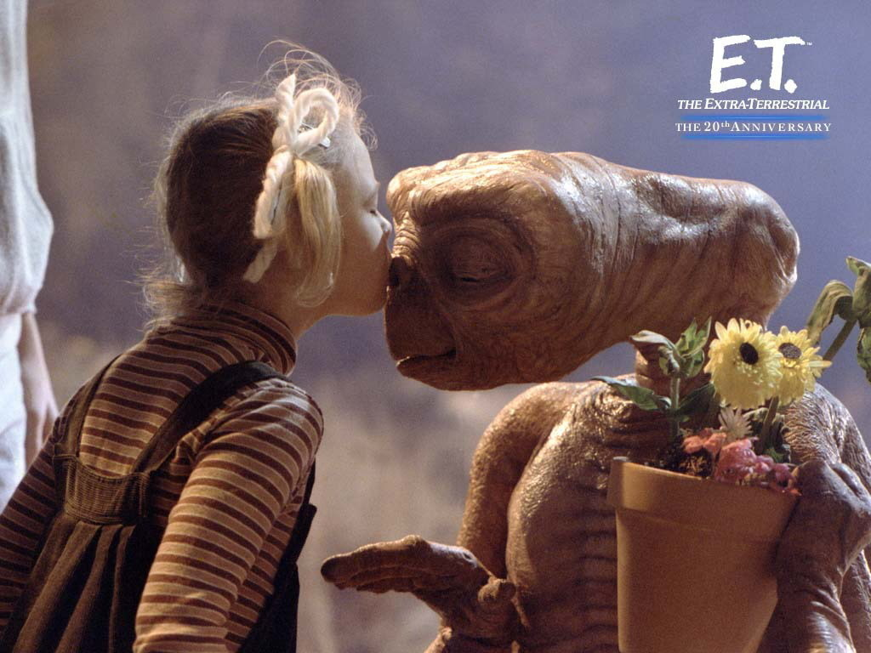
1.
Medium shot
Close shot
High angle
Low angle

Slide 3
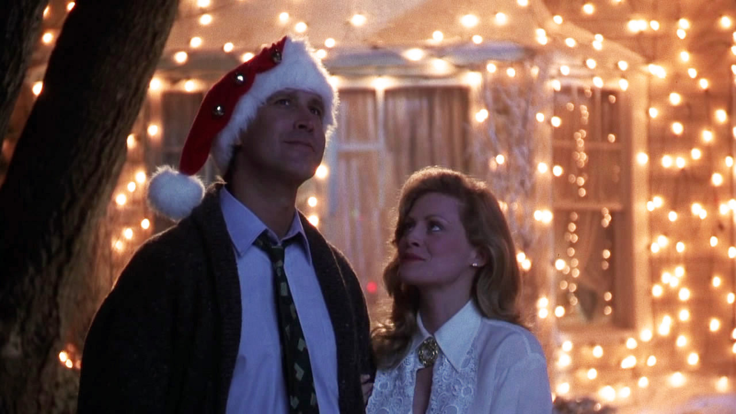
2.
Close shot
Soft focus
Close shot
High angle

Slide 4
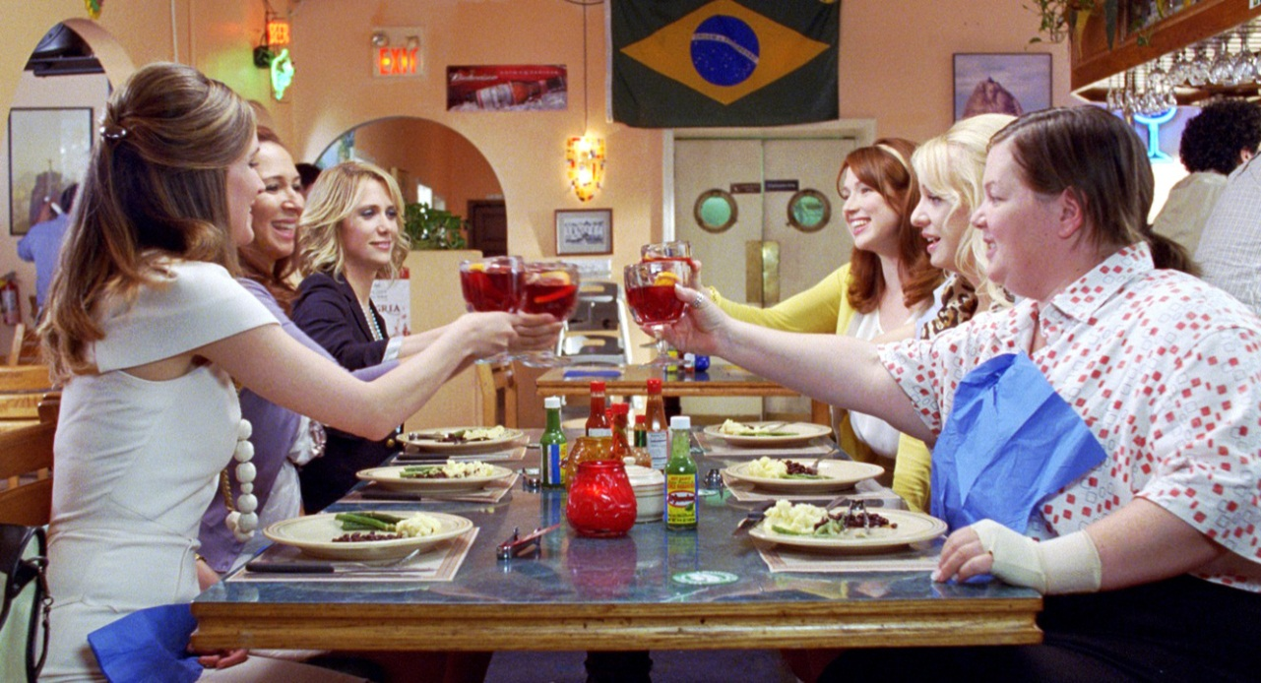
3.
Deep focus
Close shot
High angle
Canted angle

Slide 5
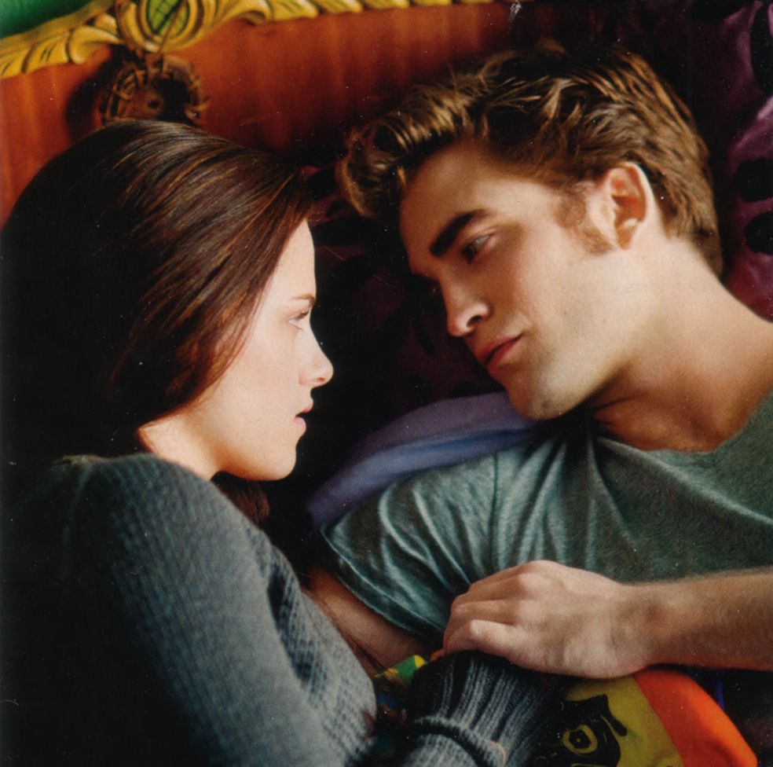
4.
Eye Level
Low angle
High angle
Establishing shot

Slide 6
5.
Close shot
Deep focus
High angle
D.Low key lighting

Slide 7
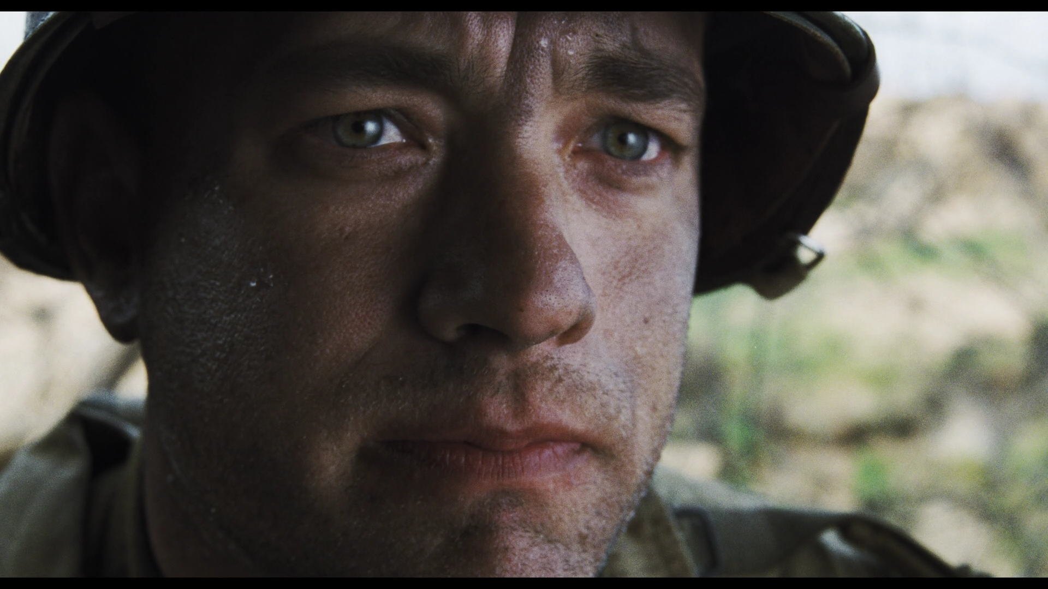
6.
Establishing shot
Close shot
Low angle
Deep focus

Slide 8
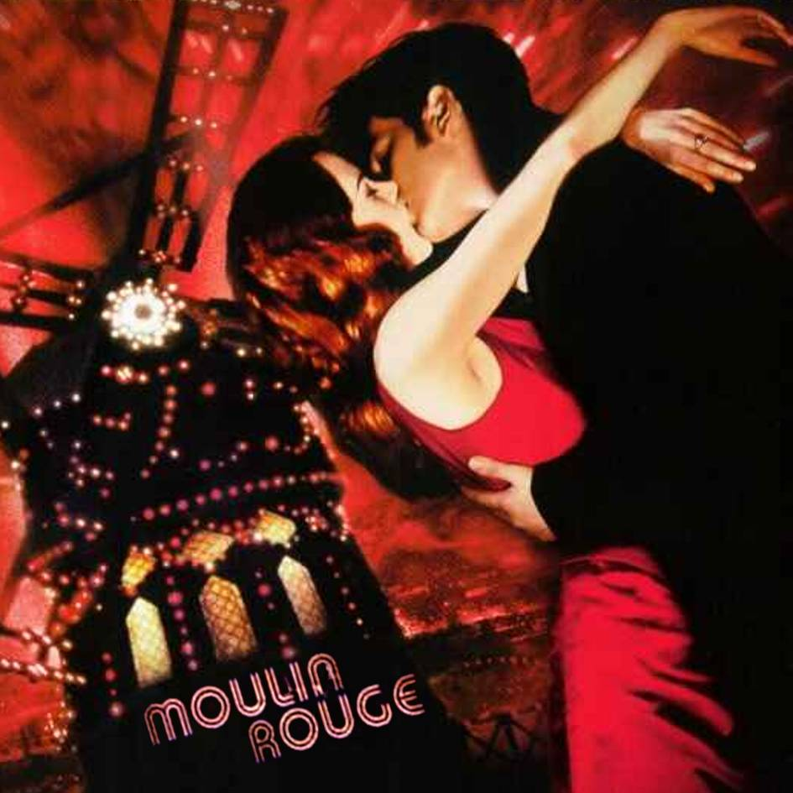
7.
Close shot
High angle
Sharp focus
Canted angle

Slide 9
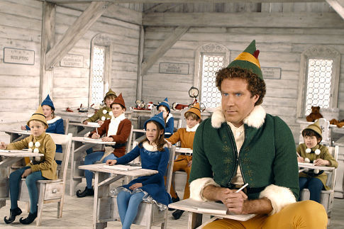
8.
High key lighting and sharp focus
Low key lighting and high angle
High key lighting and high angle
Low key lighting and close shot

Slide 10
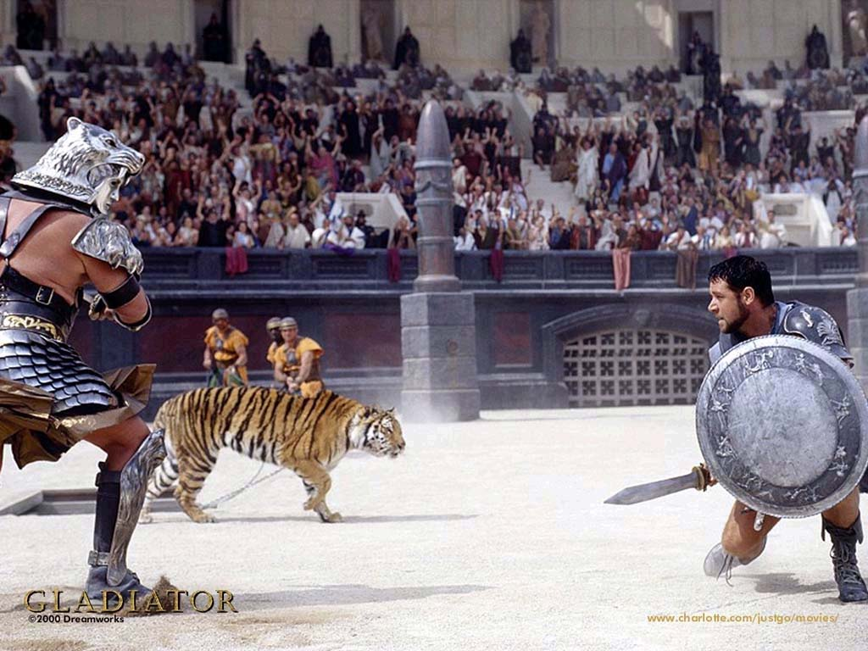
9.
A. Long shot and eye level
High angle and long shot
Rack focus and long shot
High key lighting and canted angle

Slide 11
Technique and Effect

Slide 12
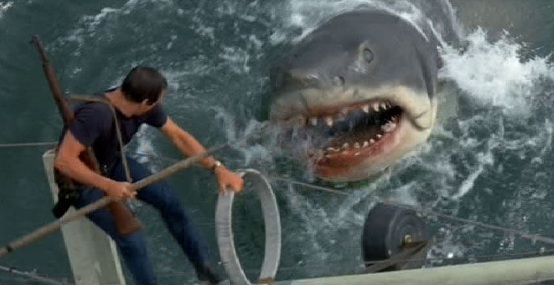
10.
What effect does the use of high angle produce?
It conveys the vulnerability of the shark in its
natural habitat
B. It highlights the danger that the man faces in
dealing with the shark
C. It blurs the line between science fiction and realism

Slide 13
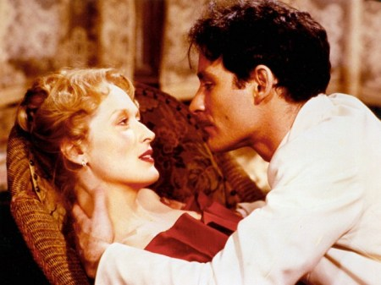
11.
Given what you know about the conventional use of soft focus, why is it employed in this image?
A. To suggest tension between the man and woman
To create a realistic portrait of a relationship
To intimate a romantic connection between the
man and woman

Slide 14
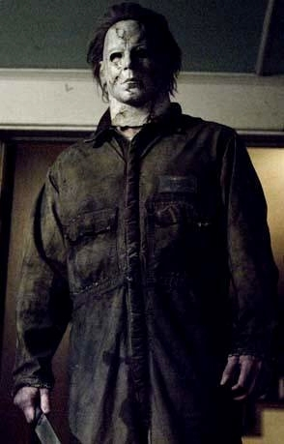
12.
Low angle is employed in this screencap of Michael Myers in Halloween. Why?
To hint at his vulnerability in a misunderstanding society
To express the figure’s confusion and feelings of inadequacy
To demonstrate his menacing and dangerous personality

Slide 15
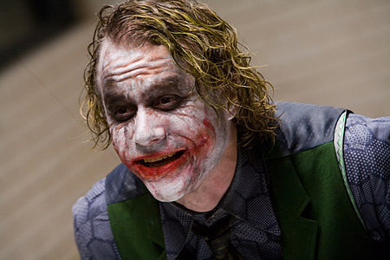
13.
Why is the use of a Dutch angle with the Joker so appropriate?
It solidifies his position as a force of chaos
It hints at his good intentions despite his strange appearance
It suggests the Joker’s vulnerability in a cruel society

Slide 16
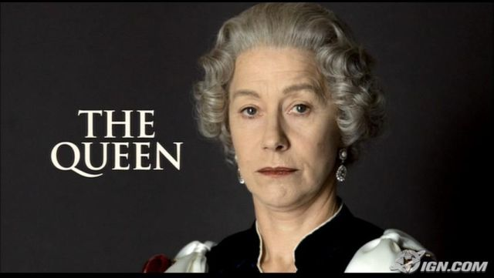
14.
Why has eye level been employed in this image?
It demonstrates the distance between the subject (a queen) and a viewer (a regular person)
It hints at the secrets lurking in the background of a royal life
It encourages a connection between the subject and the viewer

Slide 17
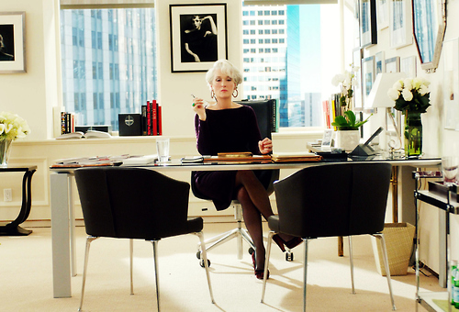
15.
Why has sharp focus been employed in this shot?
It hints that the woman is out of place in her ordered environment
It reveals the careful, meticulous attention the woman gives to her job
It plants a feeling of suspicion in the viewer’s eye about the woman’s business ethics

Slide 18
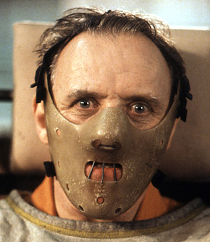
16.
While we would expect Doctor Hannibal “The Cannibal” Lecter to be featured in low key lighting, instead we see generally high key lighting being employed here. Why?
It suggests that we are to like and trust the figure
It emphasizes the apparent mental disturbance/danger of the character despite his intellectual abilities as a doc
It hints at a lonely, compassionate feel to the character’s personality

